Slide 1


Real Time Face Attendance
SUBMITTED BY:
Ramana Reddy S (20IS081)
Renati Deekshith Reddy (20IS082)
PROJECT GUIDE:
Mr.Gangadhar.M.L BE,Mtech(Phd)

Slide 2

AGENDA
Introduction to Real-Time Face Attendance Project
Implementation of Real-Time Face Attendance Project
Flow Chart: Training Part
Flow Chart: Recognition Part
Advantages of Real-Time Face Attendance Project
Limitations of Real-Time Face Attendance Project
Conclusion

Slide 3
INTRODUCTION
Real-time face attendance project is a system that uses facial recognition technology to track the presence of employees in a given workplace. It provides an efficient way to monitor attendance and improve the overall productivity of the organization. The system can be used to identify and track employees in real-time, allowing organizations to quickly and accurately monitor attendance and identify any discrepancies.
The system is designed to be easy to use and integrate into existing workflows. It can be used to monitor attendance in a variety of settings, including offices, schools, and other organizations. The system is also secure and reliable, ensuring that the data collected is accurate and secure.

Slide 4
Implementation
Real-time face attendance project can be implemented in a variety of ways. It can be used in a standalone system, or integrated into existing workflows. The system can be used to monitor attendance in a variety of settings, including offices, schools, and other organizations.
The system is also secure, as it uses facial recognition technology to ensure that the data collected is accurate and secure. The system is also cost-effective, as it eliminates the need to purchase additional hardware or software.

Slide 5
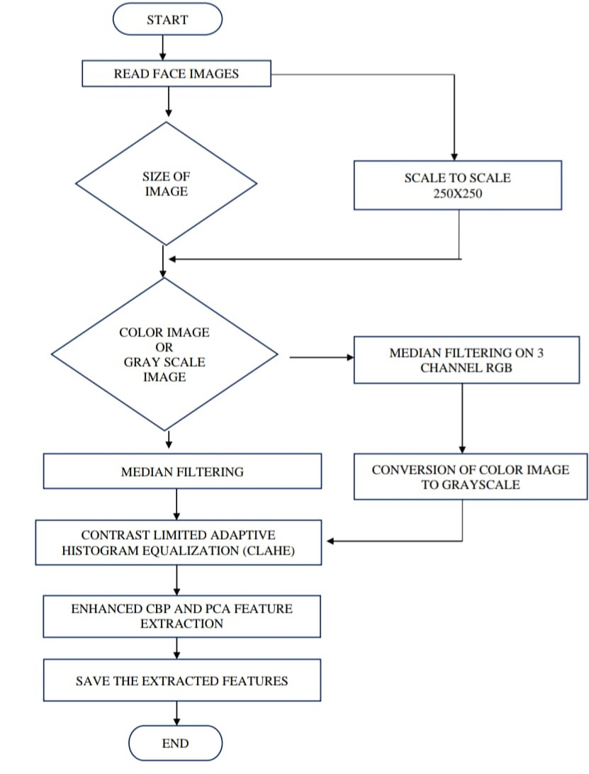
Flow Chart: Training Part

Slide 6
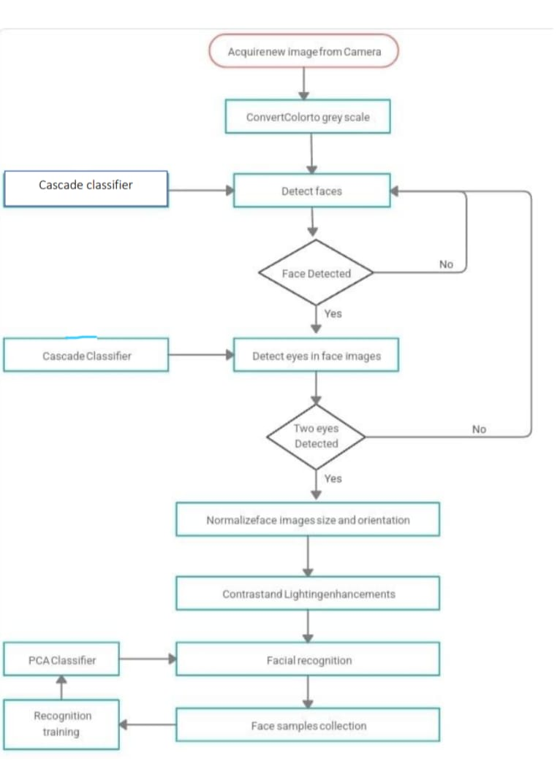
Flow Chart: Recognition Part

Slide 7
Advantages
Real-time face attendance project offers numerous advantages to organizations. It is an efficient way to track attendance, as it eliminates the need for manual attendance tracking. The system is also secure, as it uses facial recognition technology to ensure that the data collected is accurate and secure.
The system is also easy to use and integrate into existing workflows. It can be used to monitor attendance in a variety of settings, including offices, schools, and other organizations. The system is also cost-effective, as it eliminates the need to purchase additional hardware or software.

Slide 8
Limitations
Real-time face attendance project is not without its limitations. The system is limited in its ability to detect facial features, and may not be able to accurately identify individuals in certain lighting conditions or with certain hairstyles. Additionally, the system is limited in its ability to detect changes in facial features over time.
The system is also limited in its ability to detect certain facial features, such as glasses or beards. Additionally, the system is limited in its ability to detect changes in facial features over time. Finally, the system is limited in its ability to detect changes in facial expressions.

Slide 9

CONCLUSION
Real-time Face Attendance is an innovative technology that offers a secure and efficient way to track employee attendance. It offers a number of benefits, including improved accuracy and reduced administrative costs.
The system should be thoroughly tested prior to implementation, and can be integrated into existing systems or implemented as a standalone system.

